Slide 1
Chapter 1:
Introduction to Systems
Analysis and Design
By
Mr. Ojok Tonny
Bsc.IT, Msc. HIT

Slide 2
Objectives
Understand the fundamental systems development life cycle and its four phases.
Understand the evolution of systems development methodologies.
Be familiar with the Unified Process and its extensions.
Be familiar with the different roles on the project team.

Slide 3
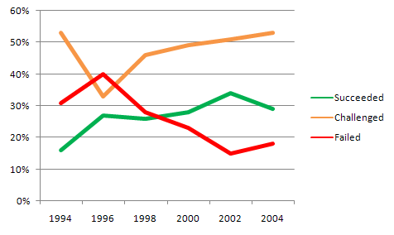
Why Should We Care?
Would you buy a car that only had a 28% chance of driving off the lot with no problems?
Notes:
Source: The Standish Group 2006 Chaos Report

Slide 4
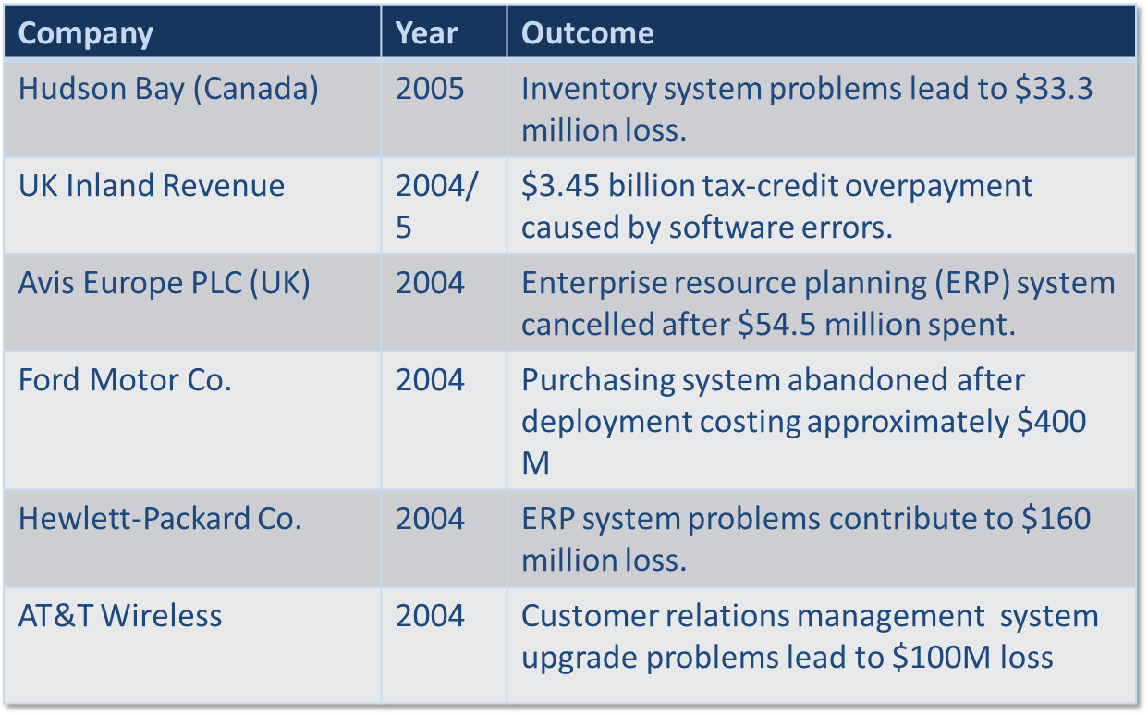
Recent Significant IT Failures
Notes:
Source: Charette, Robert N., “Why Software Fails,” IEEE Spectrum Online, Sept. 2005.

Slide 5
SYSTEMS DEVELOPMENT LIFE CYCLE

Slide 6
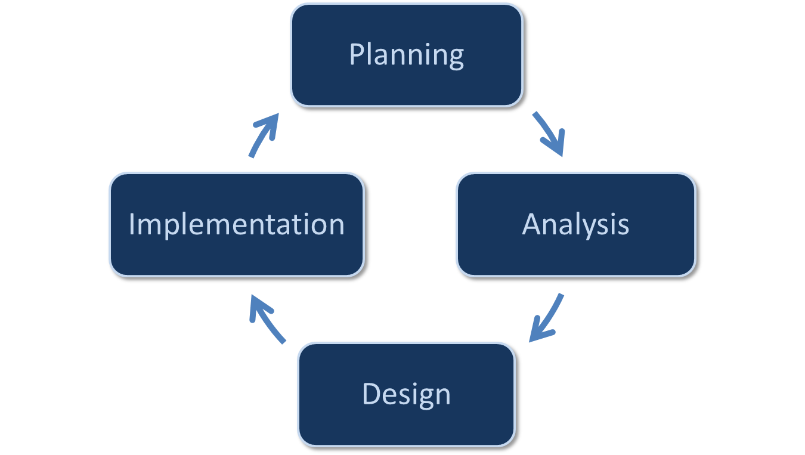
Systems Development Life Cycle

Slide 7
SDLC: Planning
Project Initiation
  Develop a system request
  Conduct a feasibility analysis
Project Management
  Develop work plan
  Staff the project
  Control and direct the project
Why should we build this system?

Slide 8
SDLC: Analysis
Develop analysis strategy
Gather requirements
Develop a system proposal
What should the system do for us?
Where and when will it be used?

Slide 9
SDLC: Design
Develop a design strategy
Design architecture and interfaces
Develop databases and file specifications
Develop the program design
How will we build the system?

Slide 10
SDLC: Implementation
Construct system
Install system
  Implement a training plan for the users
Establish a support plan
Build the system!

Slide 11
Putting the SDLC Together
Each phase consists of steps that lead to specific deliverables
The system evolves through gradual refinement
Once the system is implemented, it may go back into a planning phase for its next revision, a follow-on system, or maintenance releases

Slide 12
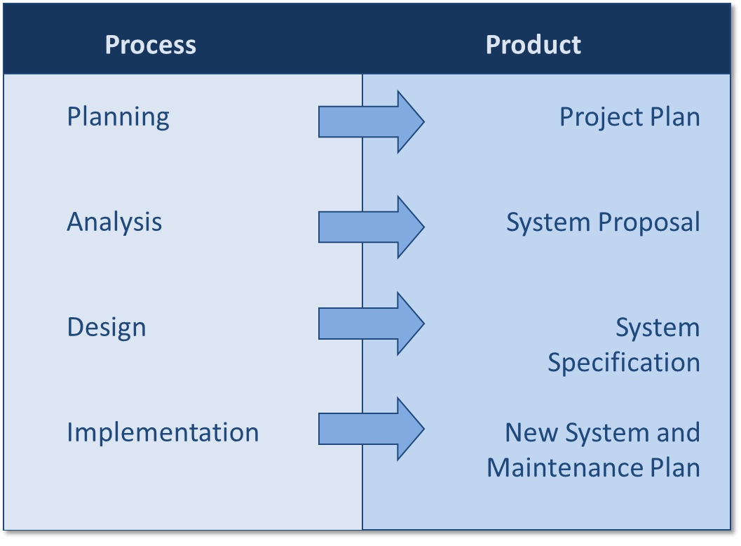
Processes and Deliverables

Slide 13
SYSTEMS DEVELOPMENT METHODOLOGIES

Slide 14
Systems Development Methodologies
A methodology is a formalized approach to implementing the SDLC
Well-known methodologies include:
  Waterfall development
  Parallel development
  V-model
  Rapid application development
  Agile development

Slide 15
Categories of Methodologies
Structured Design
  Waterfall Development
  Parallel Development
Rapid Application Development
  Phased
  Prototyping
  Throwaway Prototyping
Agile Development
  eXtreme Programming

Slide 16
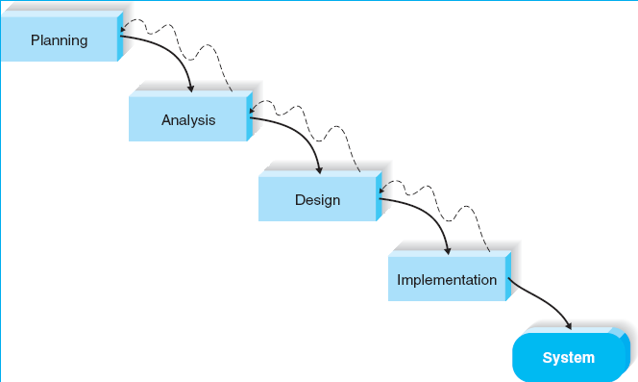
Structured Design 1
Waterfall Development

Slide 17
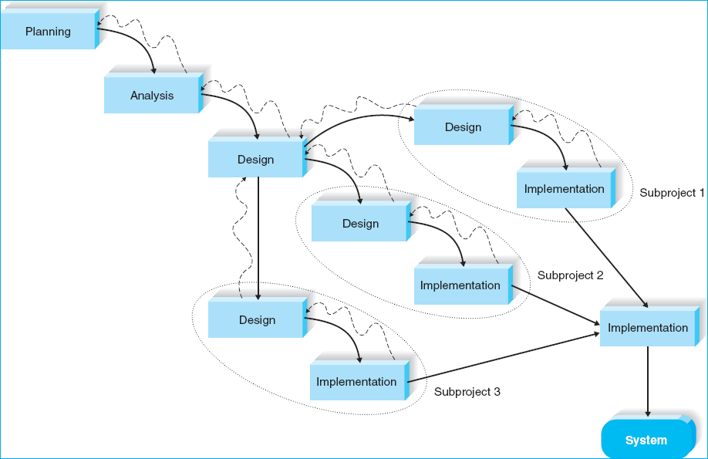
Structured Design 2
Parallel Development

Slide 18
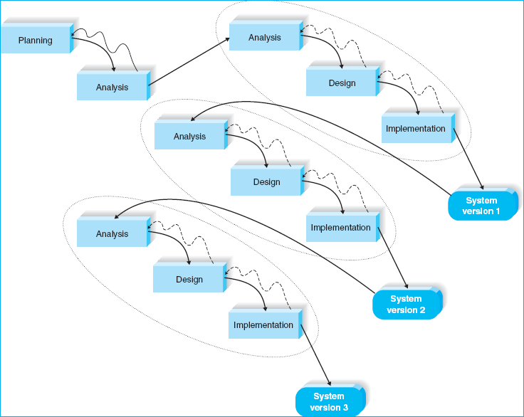
Rapid Application Development 1
Phased Development

Slide 19
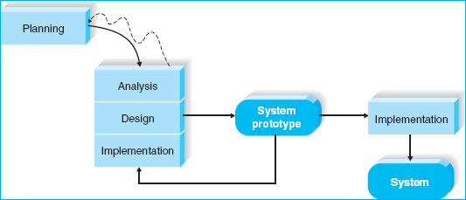
Rapid Application Development 2
System Prototyping

Slide 20
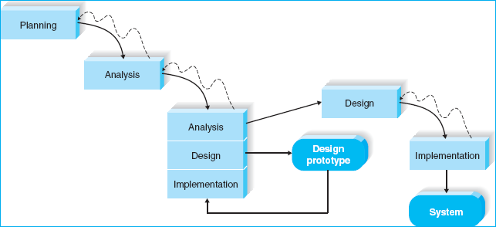
Rapid Application Development 3
Throwaway Prototyping

Slide 21
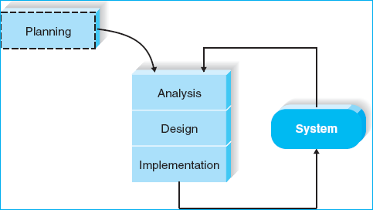
Agile Development
Extreme Programming

Slide 22
Selecting the Right Methodology
Usefulness for | Waterfall | Parallel | Phased | Prototyping | Throwaway Prototyping | Extreme Programming
Unclear user requirements | Poor | Poor | Good | Excellent | Excellent | Excellent
Unfamiliar technology | Poor | Poor | Good | Poor | Excellent | Poor
Complex systems | Good | Good | Good | Poor | Excellent | Poor
Reliable systems | Good | Good | Good | Poor | Excellent | Good
Short time schedule | Poor | Good | Excellent | Excellent | Good | Excellent
Schedule visibility | Poor | Poor | Excellent | Excellent | Good | Good

Slide 23
Object-Oriented Analysis & Design
Attempt to balance emphasis on data and process
Uses Unified Modeling Language (UML)
Characteristics of OOAD:
  Use-case Driven
  Architecture Centric
  Iterative and Incremental

Slide 24
THE UNIFIED PROCESS

Slide 25
The Unified Process
A specific methodology that maps out when and how to use the various UML techniques for object-oriented analysis and design
A two-dimensional process consisting of phases and flows
  Phases describe how the system evolves over time
  Workflows are collections of tasks that occur throughout the lifecycle, but vary in intensity

Slide 26
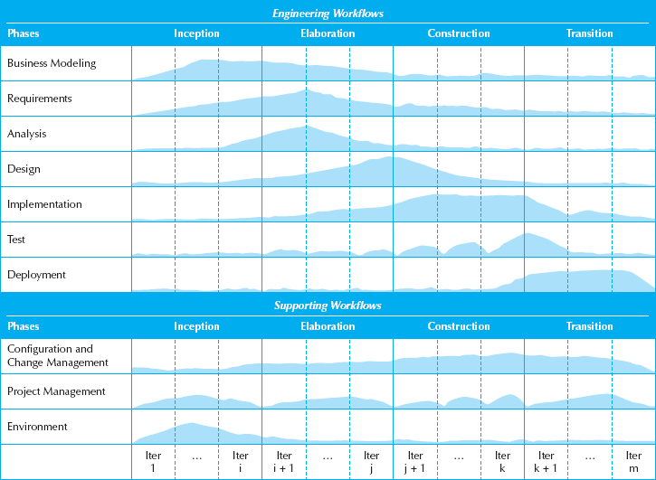
The Unified Process

Slide 27
Unified Process Phases
Inception
Elaboration
Construction
Transition

Slide 28
Engineering Workflows
Business modeling
Requirements
Analysis
Design
Implementation
Testing
Deployment

Slide 29
Supporting Workflows
Project management
Configuration and change management
Environment
Operations and support*
Infrastructure management*
* Part of the enhanced unified process

Slide 30
THE UNIFIED MODELING LANGUAGE

Slide 31
Unified Modeling Language
Provides a common vocabulary of object-oriented terms and diagramming techniques rich enough to model any systems development project from analysis through implementation
Version 2.0 has 14 diagrams in 2major groups:
  Structure diagrams
  Behavior diagrams

Slide 32
UML Structure Diagrams
Represent the data and static relationships in an information system
  Class
  Object
  Package
  Deployment
  Component
  Composite structure

Slide 33
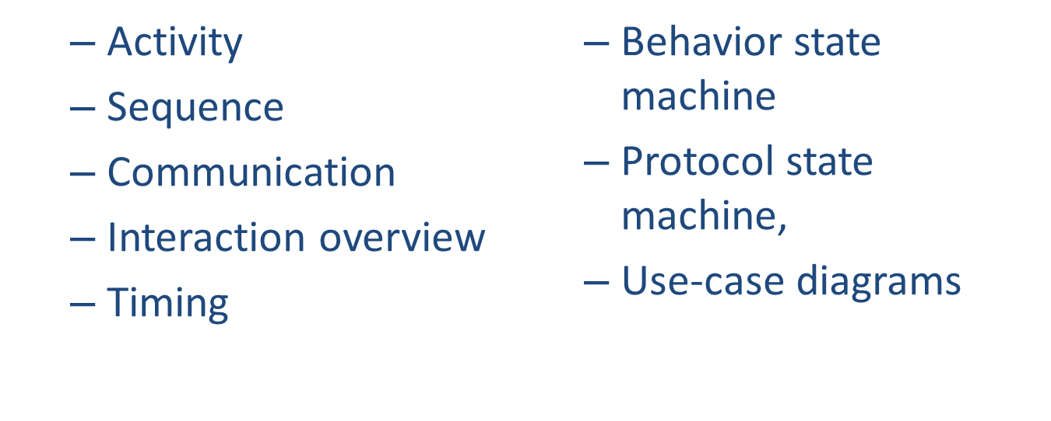
UML Behavior Diagrams
Depict the dynamic relationships among the instances or objects that represent the business information system

Slide 34
PROJECT TEAM ROLES AND SKILLS

Slide 35

Project Team Skills
Project team members are change agents who find ways to improve their organization
A broad range of skills is required, including
  Technical
  Business
  Analytical
  Interpersonal
  Management
  ethical
Notes:
Image source: Microsoft Office clipart (http://office.microsoft.com)

Slide 36
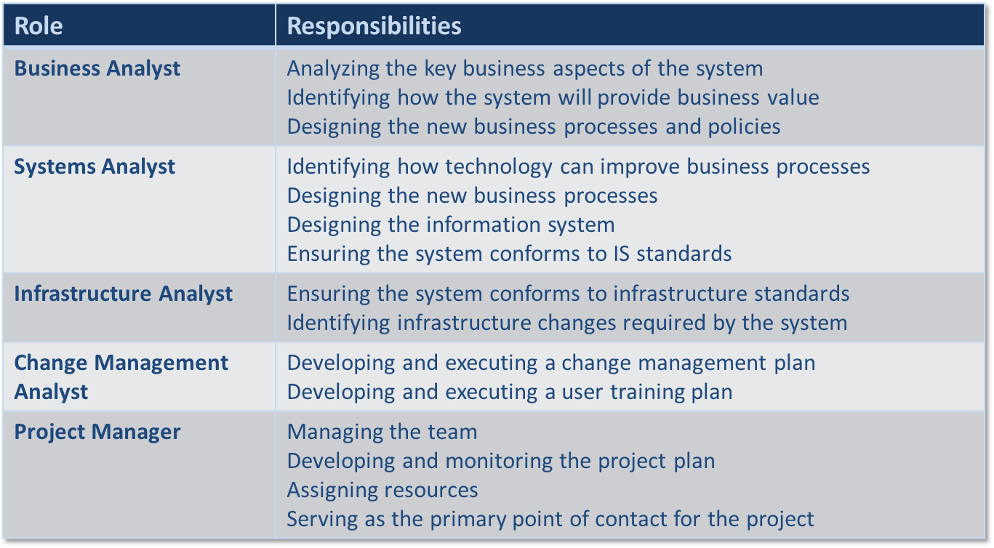
Project Team Roles

Slide 37
Summary
All systems development projects follow essentially the same process, called the system development life cycle (SDLC)
System development methodologies are formalized approaches to implementing SDLCs
Object-Oriented Systems Analysis and Design (OOSAD) uses a use-case-driven, architecture-centric, iterative, and incremental information systems development approach

Slide 38
Summary
The Unified Process is a two-dimensional systems development process described with a set of phases and workflows
The Unified Modeling Language, or UML, is a standard set of diagramming techniques
The project team needs a variety of skills

